Slide 1

Array Multiplier
Computer Organization and Architecture | Computer Arithmetic
Computer Organization and Architecture | Chapter: Computer Arithmetic | Bachelor of Engineering
DISCOVER · LEARN · EMPOWER
Notes:
Welcome everyone to today's lecture on Computer Arithmetic. We will focus specifically on the Array Multiplier, a fundamental building block for high-speed arithmetic operations. This topic is crucial for understanding how hardware executes multiplication efficiently. Let us begin our journey into the mechanics of digital multiplication.

Slide 2
Course Outcomes
SLIDE 2 / 10
Course Outcome
CO | BT LEVEL | DESCRIPTION
CO1 | BT3 | Apply number systems and digital logic to design basic digital circuits
CO2 | BT4 | Analyze register organization and instruction set architecture
CO3 | BT3 | Implement computer arithmetic algorithms and floating-point operations
CO4 | BT5 | Analyze memory hierarchy and input-output organization
CO5 | BT6 | Evaluate control unit design and pipelining performance
Chandigarh University
2 / 10
Notes:
Today's session directly addresses Course Outcome 3. You will learn to implement the specific algorithm for array multiplication. This skill allows you to design hardware that performs floating-point and integer operations correctly. Mastering this is essential for your engineering practice.

Slide 3
Learning Objectives
SLIDE 3 / 10
Learning Outcomes
1
Define the array multiplier as a combinational logic circuit for multiplication.
2
Analyze the structure of the array using AND gates and adders.
3
Calculate the propagation delay and hardware complexity for n-bit multipliers.
4
Differentiate between serial and parallel multiplication approaches in hardware design.
Chandigarh University
3 / 10
Notes:
By the end of this lecture, you will be able to define the array multiplier clearly. You will analyze how AND gates and adders form the core structure. We will also calculate the delay and complexity to understand performance trade-offs. Finally, you will differentiate this parallel approach from serial methods.

Slide 4
Lecture
SLIDE 4 / 10
Definition and Basic Concept
1
An array multiplier is a combinational circuit that multiplies two binary numbers.
2
It generates partial products by ANDing each bit of the multiplicand with the multiplier.
3
The circuit uses a grid of adders to sum these partial products simultaneously.
4
This parallel approach is faster than serial shift-and-add methods for large numbers.
Chandigarh University
4 / 10
Notes:
Think of the array multiplier as a massive grid of logic gates working in parallel. It takes two binary numbers and generates partial products instantly. Unlike serial methods that shift and add one by one, this sums everything at once. This makes it significantly faster for high-speed computing applications.

Slide 5
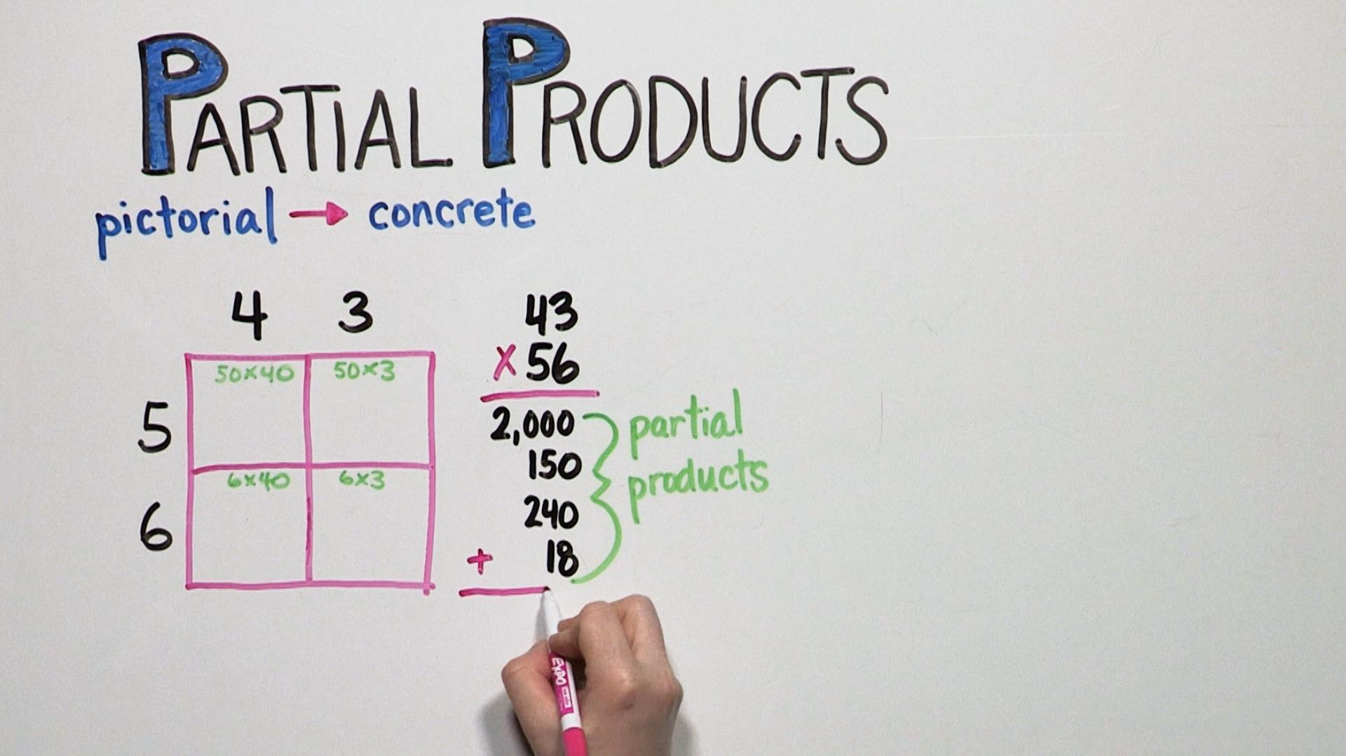
Structure
SLIDE 5 / 10
Partial Product Generation
1
Each bit of the multiplier is ANDed with every bit of the multiplicand.
2
This creates n rows of partial products for two n-bit numbers.
3
The partial products are aligned based on the position of the multiplier bit.
4
The first row is simply the multiplicand if the least significant bit is one.
Source: image.pbs.org
Chandigarh University
5 / 10
Notes:
Let's look at how we generate the partial products. Every bit of the multiplier is ANDed with the entire multiplicand. This creates n rows of results that need to be summed. The alignment is critical because each row represents a shifted version of the multiplicand.

Slide 6
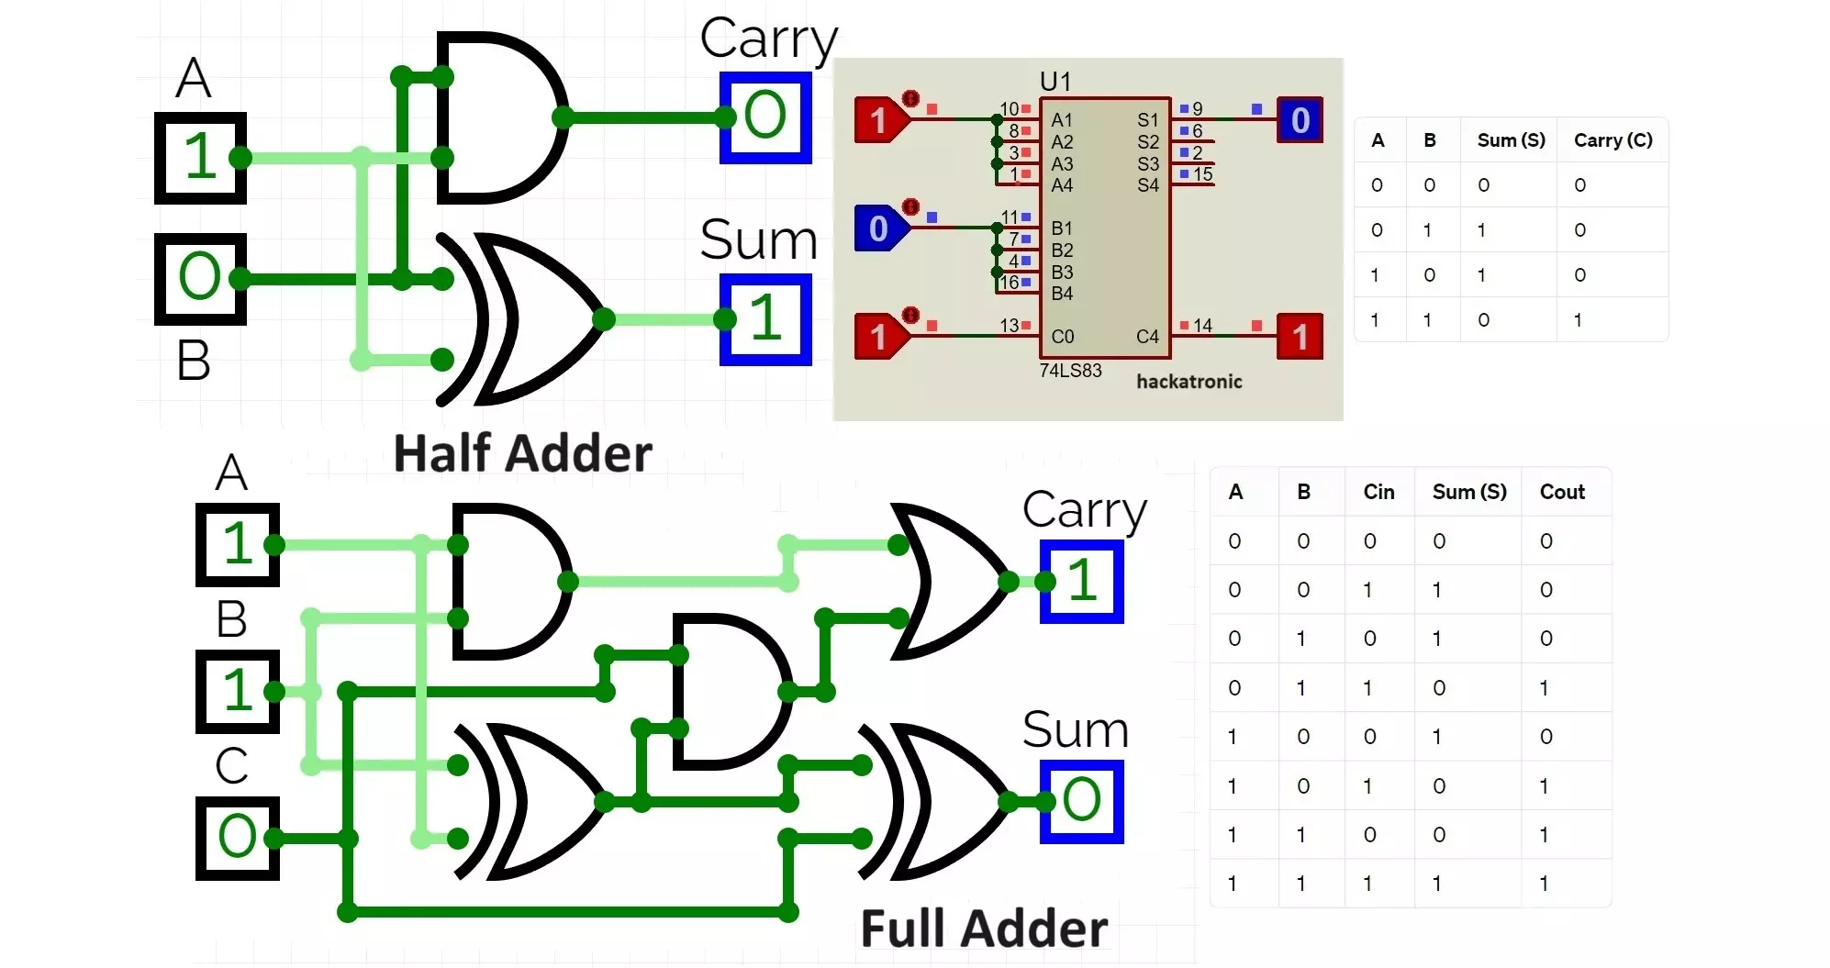
Structure
SLIDE 6 / 10
Summation using Adders
EACH ADDER SUMS THREE INPUTS
two partial product bits and a carry-in.
• Half adders and full adders are arranged in a diagonal array structure.
• The sum output moves to the next column while the carry moves up.
• The final column produces the most significant bits of the product.
Source: www.hackatronic.com
Chandigarh University
6 / 10
Notes:
The summation happens using a diagonal array of adders. Each adder takes two partial product bits and a carry from the previous stage. The sum moves right while the carry moves up to the next row. This diagonal flow ensures all bits are summed correctly in parallel.

Slide 7
Worked Example
SLIDE 7 / 10
3-bit Multiplication
PARTIAL PRODUCTS ARE
110, 000, and 110 shifted left by two positions.
• Multiply 110 (6) by 101 (5) using a 3-bit array multiplier.
• Summing these rows yields the binary result 11110 which equals 30.
• The circuit performs this calculation in a single clock cycle without shifting.
Chandigarh University
7 / 10
Notes:
Let's work through a concrete example. We multiply 110 by 101. The partial products are 110, 000, and 110 shifted. When we sum these, we get 11110, which is 30 in decimal. This entire process happens in parallel, unlike manual multiplication which requires shifting.

Slide 8
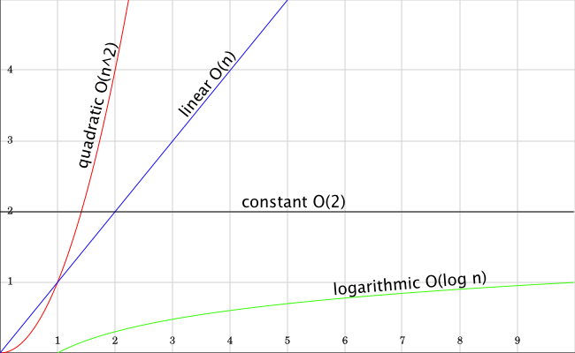
Performance
SLIDE 8 / 10
Delay and Complexity
1
The propagation delay is proportional to the number of bits, roughly O(n).
2
Hardware complexity grows quadratically, requiring O(n²) gates for an n-bit multiplier.
3
The critical path runs diagonally through the array of adders.
4
Higher bit widths significantly increase the time required for the final result.
Source: blog.hiphipjorge.com
Chandigarh University
8 / 10
Notes:
Performance is a key consideration here. The delay is proportional to the number of bits, roughly O(n). However, the hardware complexity grows quadratically, meaning O(n²) gates. This is why we use this for moderate sizes but switch to other methods for very large numbers.

Slide 9
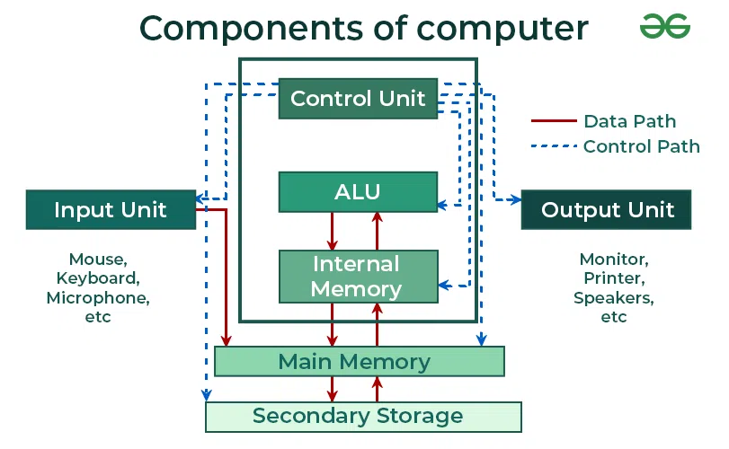
Lecture
SLIDE 9 / 10
Key Takeaways
1
Array multipliers use parallel logic to generate and sum partial products instantly.
2
The structure relies on a grid of AND gates and diagonal adder arrays.
3
This method offers high speed but requires significant hardware resources.
4
It is ideal for applications where speed is more critical than area.
Source: media.geeksforgeeks.org
Chandigarh University
9 / 10
Notes:
To summarize, array multipliers use parallel logic for instant results. They rely on a grid of AND gates and diagonal adders. While they are fast, they consume a lot of hardware. Use them when speed is your primary design constraint.

Slide 10
Lecture
SLIDE 10 / 10
References
COMPUTER ORGANIZATION AND DESIGN
The Hardware/Software Interface — David A. Patterson, John L. Hennessy
COMPUTER ARCHITECTURE
A Quantitative Approach — John L. Hennessy, David A. Patterson
• Computer Organization and Architecture — William Stallings
• Computer System Architecture — M. Morris Mano & Rajib Mall
• Computer Organization — Carl Hamacher, Zvonko Vranesic, Safwat Zaky
Chandigarh University
10 / 10
Notes:
These references provide the theoretical foundation for the concepts discussed today. I encourage you to read the chapters on arithmetic operations in Stallings and Mano. The works by Patterson and Hennessy offer excellent insights into hardware-software interfaces. Thank you for your attention.

